Slide 1
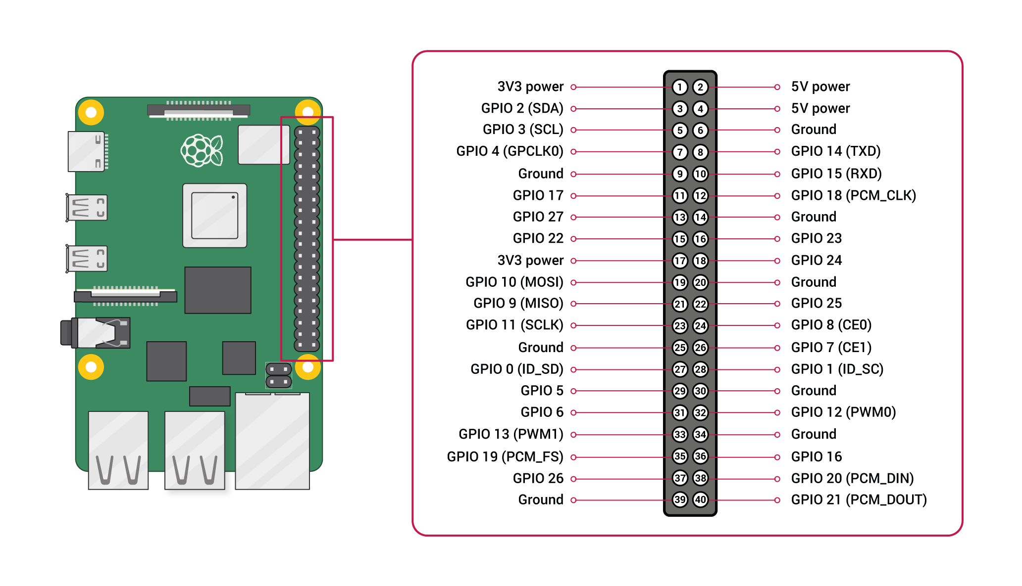
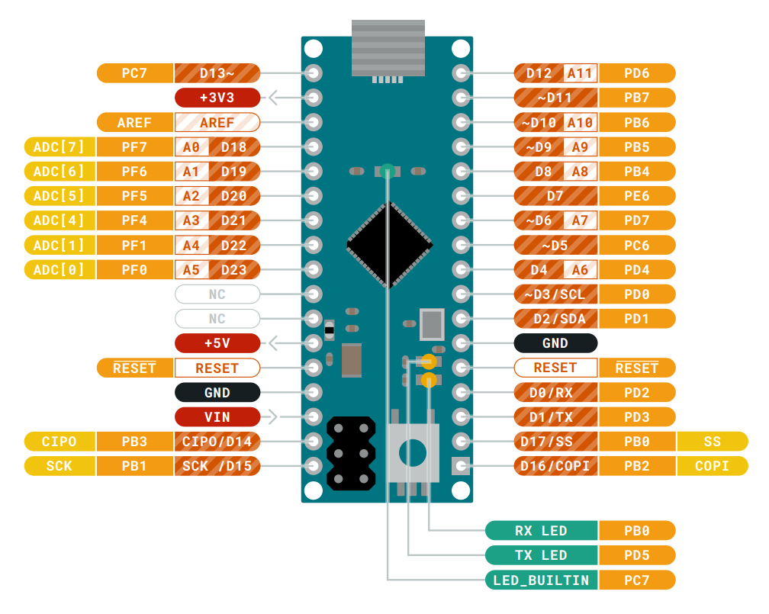
USB-A 1
Power Supply
5V
GND
S
HES 1
-
Micro USB
+
S
HES 2
-
+
S
HES 3
-
+
S
HES 4
-
+

